Slide 1
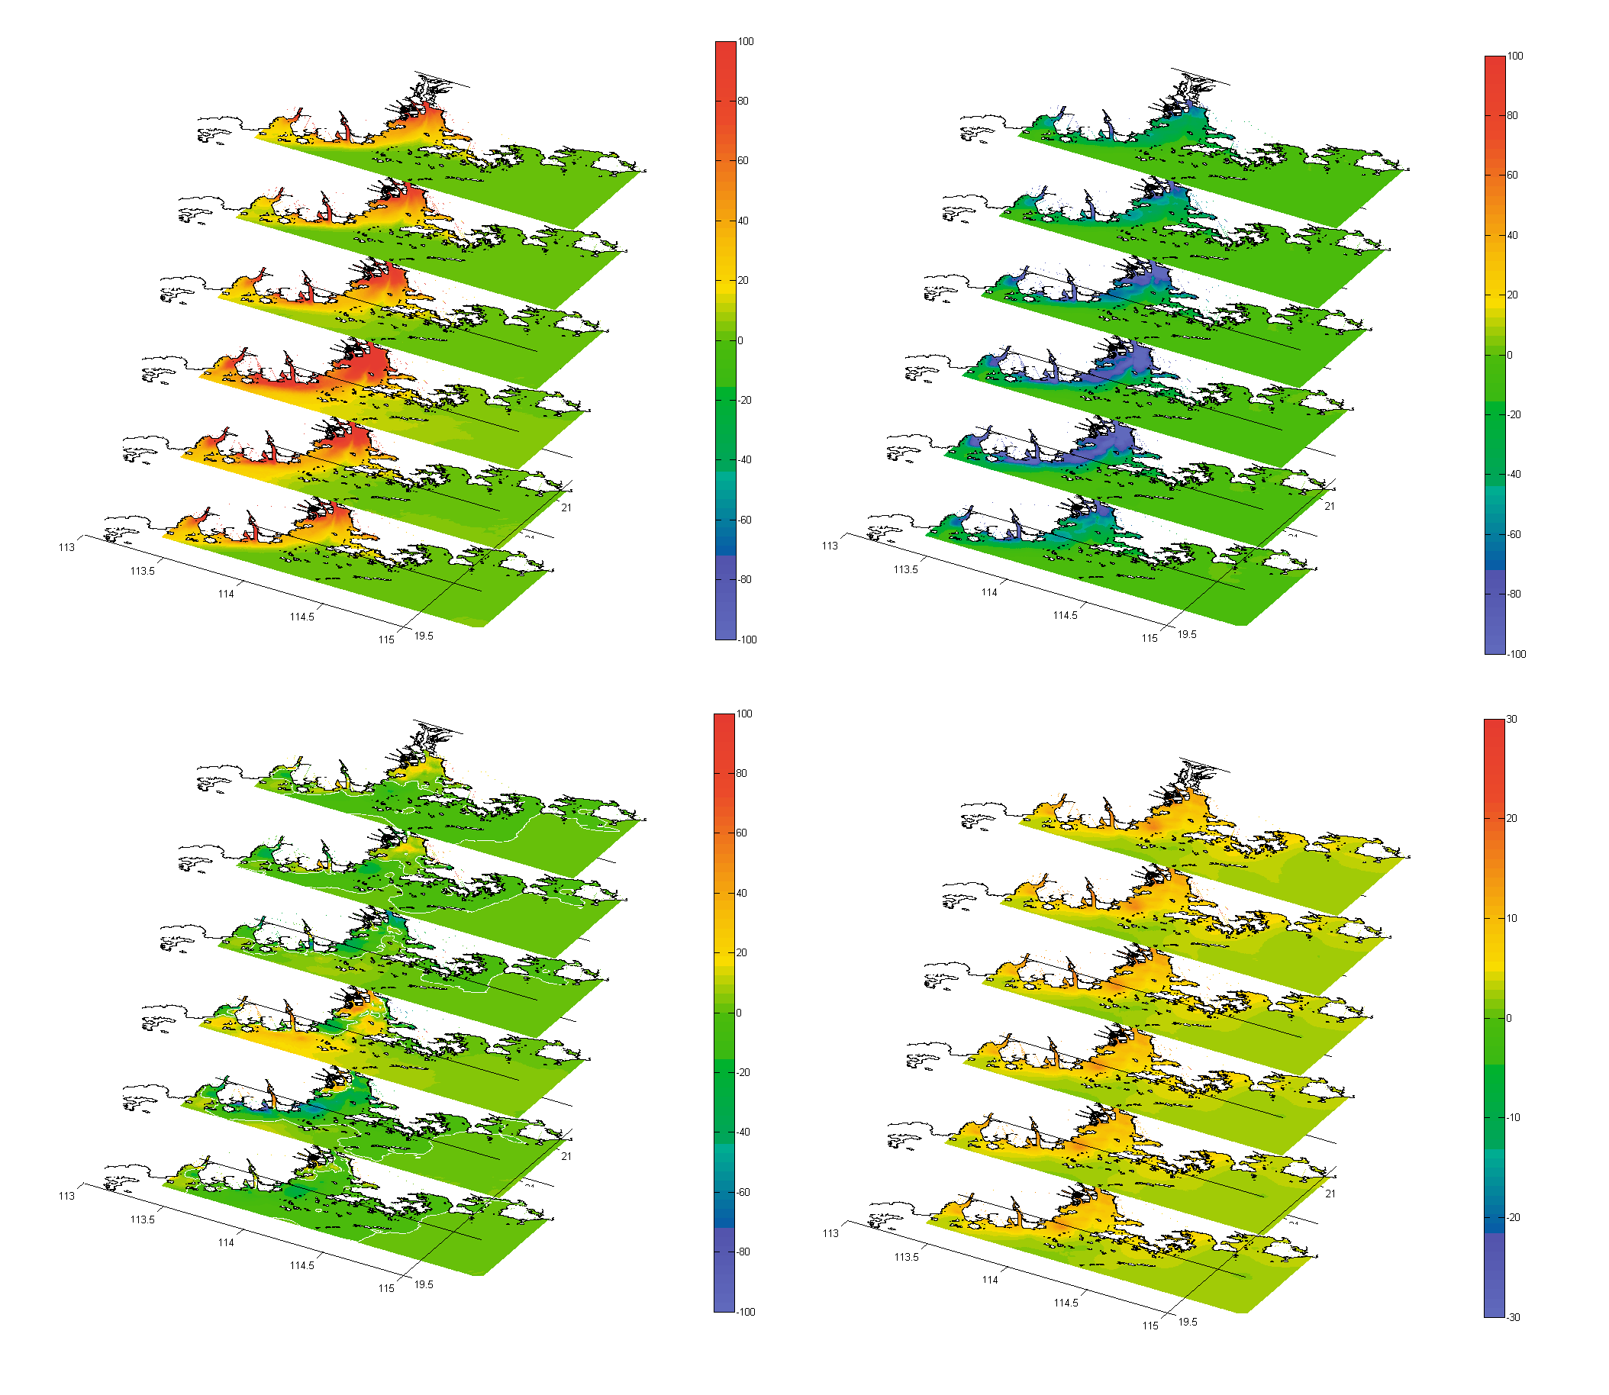
January
January
March
March
May
May
July
July
September
September
November
November
January
January
March
March
May
May
July
July
September
September
November
November
Notes:
Figure 9. (a) Monthly averaged POC deposition flux; (b) Monthly averaged DIC exchange Flux; (c) Monthly averaged net carbon flux (carbon Export) from overlying water to sediment; (d) Monthly averaged POC burial flux in sediment.

